Slide 1
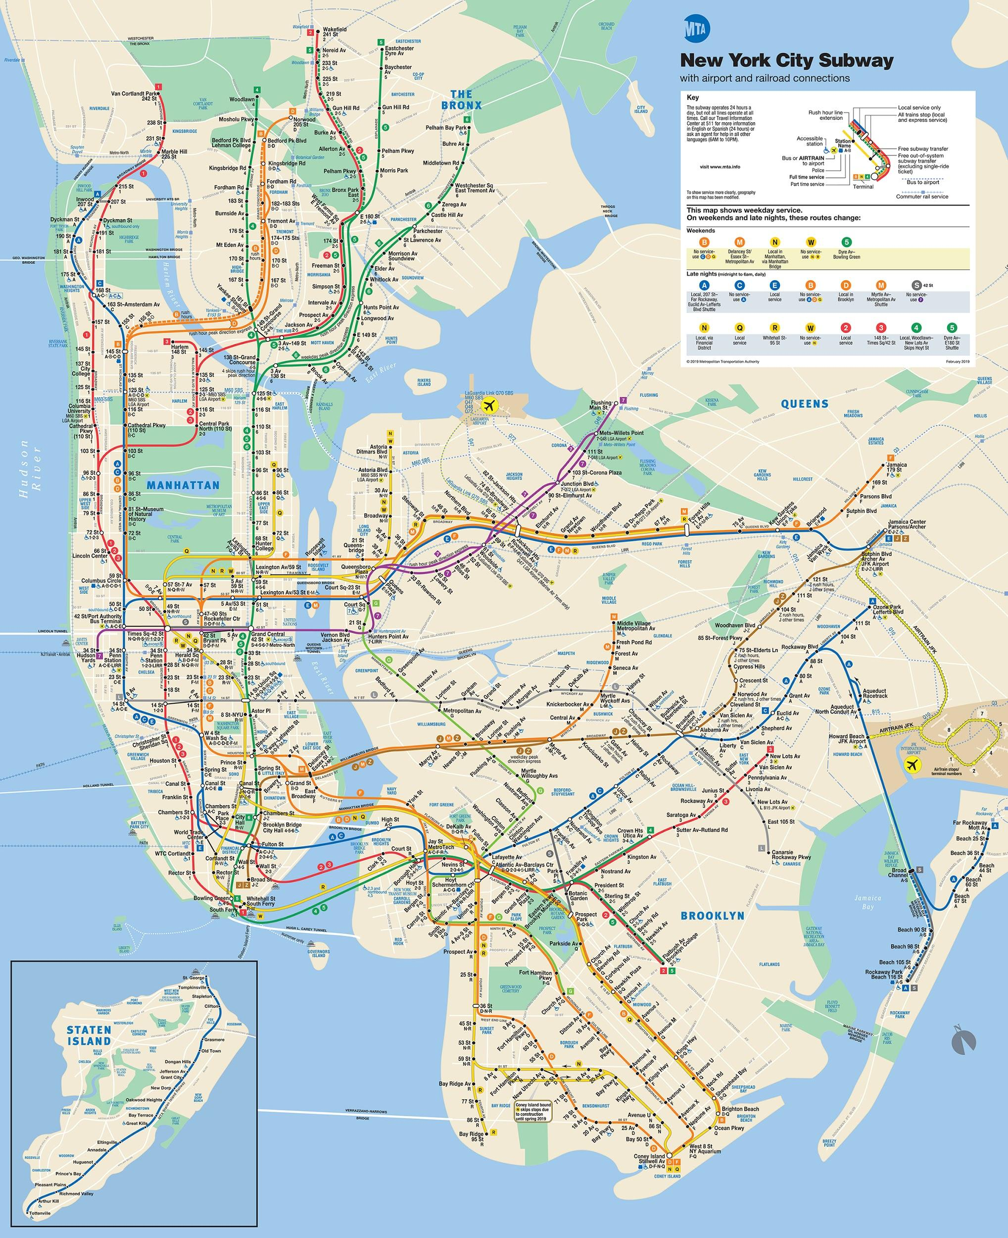

Jamaica Bay
Wildlife Refuge
Notes:
All of the birds that we’ve seen and many more live in a special place called the Jamaica Bay Wildlife Refuge. Define refuge for students.
Have students identify where the school is on the map. Note that the refuge has lots of blue and green, indicating water and trees.
This is all protected by the National Park Service, keeping it safe for wildlife to live and thrive

Slide 2
Have you ever wanted
to fly?

Slide 3
Have you ever wanted
to fly?
What kind of bird would you fly like?

Slide 4


Slide 5
Why can’t we fly?

Slide 6
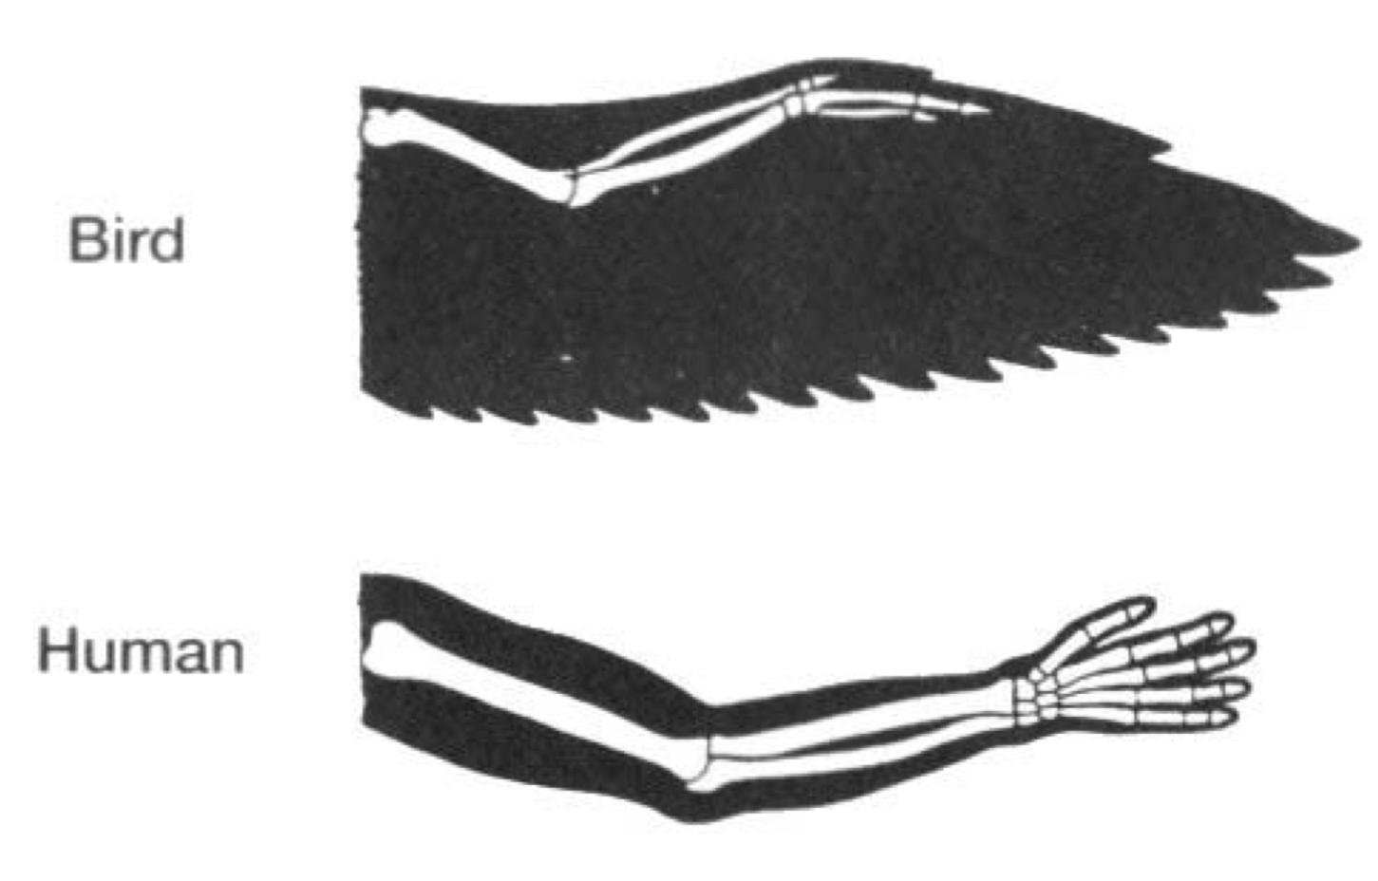
Why can’t we fly?
Bird adaptations

Slide 7
Why can’t we fly?
Bird adaptations
Wings
Feathers
Notes:
Wings help birds to catch the wind like a kite or a sail
Whenever you see a bird with its beak in its feathers, it is often putting them in order

Slide 8
Why can’t we fly?
Bird adaptations
Wings
Feathers
Strength
Notes:
A bird has to be able to lift twice its body weight to fly

Slide 9
Why can’t we fly?
Bird adaptations
Wings
Feathers
Strength
Hollow Bones
Notes:
Their bones are hollow like a straw

Slide 10
Why can’t we fly?
Bird adaptations
Wings
Feathers
Strength
Hollow Bones
Aerodynamic
Notes:
Have students try and define AERODYNAMIC looking for hits within the word

Slide 11
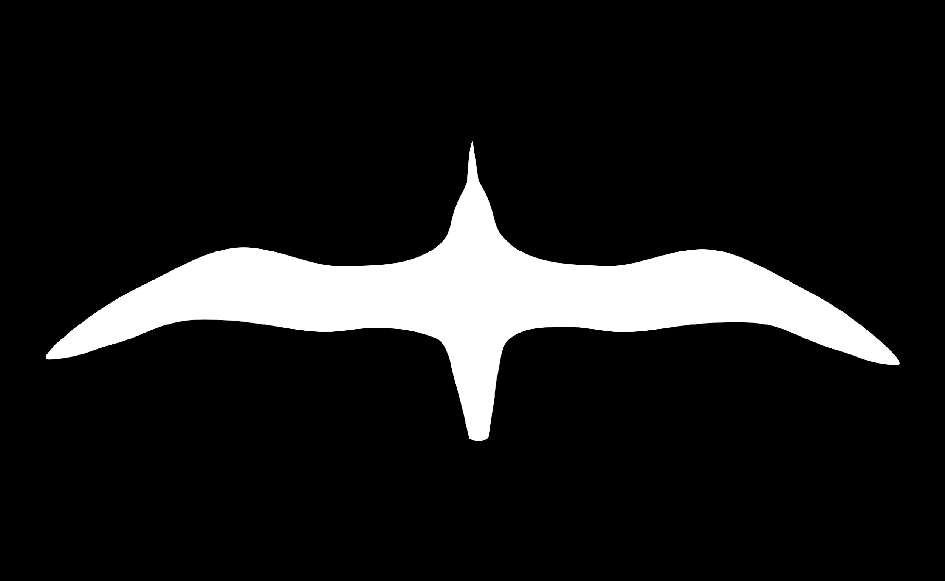

Aerodynamic:
A shape that allows air to move past smoothly

Slide 12
Different kinds of wings
do different kinds of things
Speed
Quick take off
Soaring in circles
Gliding
Notes:
Birds need speed to catch their prey in mid air like falcons catching pigeons, or tree swallows catching insects
Quick take offs for necessary for birds to escape predators
Birds who look for prey from above, will often soar in circles
Gliding is important for birds who need to travel long distance, especially useful for migratory birds

Slide 13
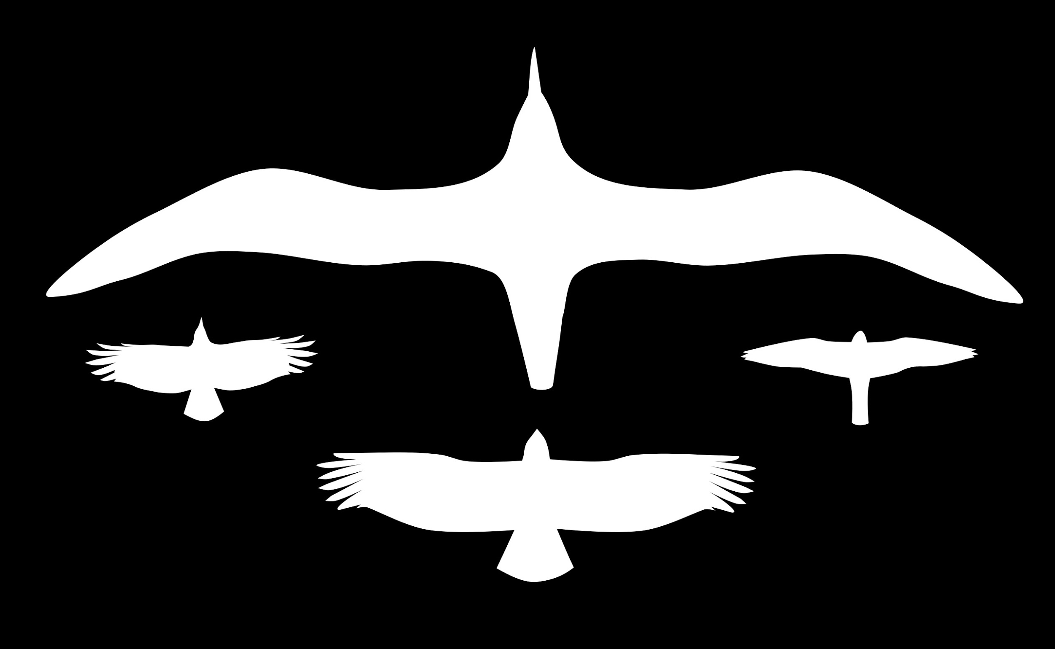
Long wingspan for gliding
Short wings for
quick takeoff
Pointed ends for speed
Slotted ends for steering

Slide 14
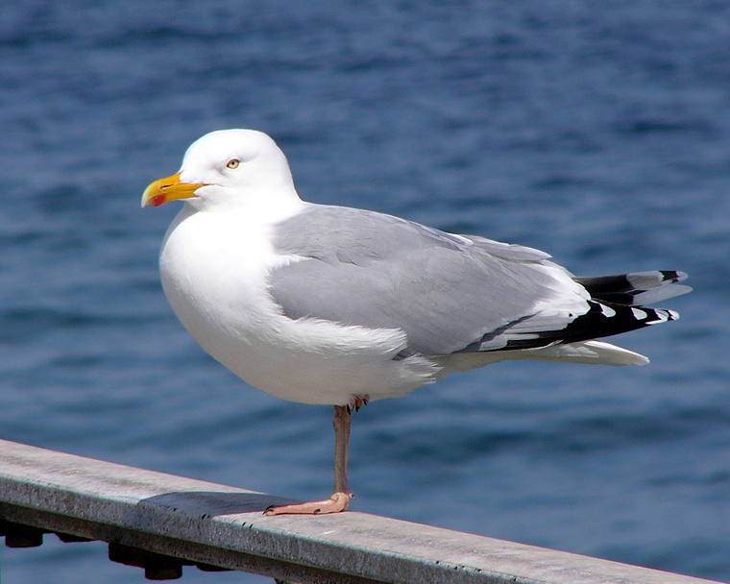
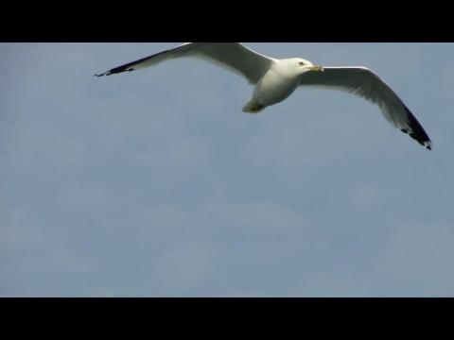
Herring Gull
Gulls have very long wings compared to their body.
This adaptation helps the bird glide on the winds.
GLIDE
Notes:
Gliding wings are often more than twice the size of the bird’s body.
Gliding is important for saving energy.
Herring Gulls are found in open areas with lots of air movement.
Another bird with this wingtype is called the Albatross. It has a wingspan of 12 ft, from wingtip to wingtip. It nests on islands in the middle of the ocean and has been known to not land for a year at a time.

Slide 15
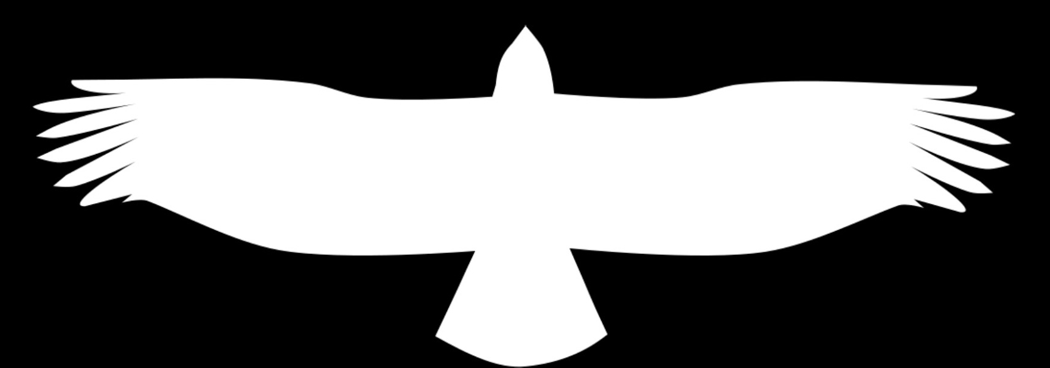
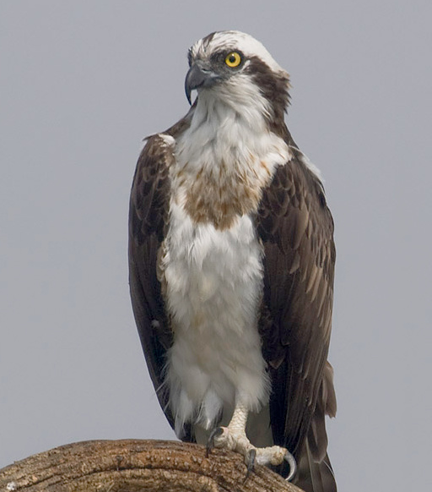
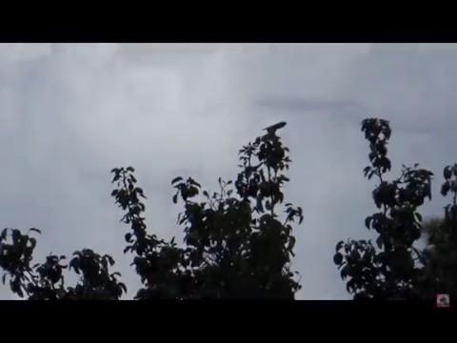
Osprey
Osprey also have large wings compared to its body, but they are wider which helps with soaring.
What else is different from the Herring Gull wings?
SOAR
Notes:
Soaring wings are wider than the glider wings, allowing it to catch more wind. You will often see one of these birds soaring in circles looking for prey.
Students should identify that the wings are different from the gliding wings because of the spaces between the end feathers. This enables the bird to steer.

Slide 16
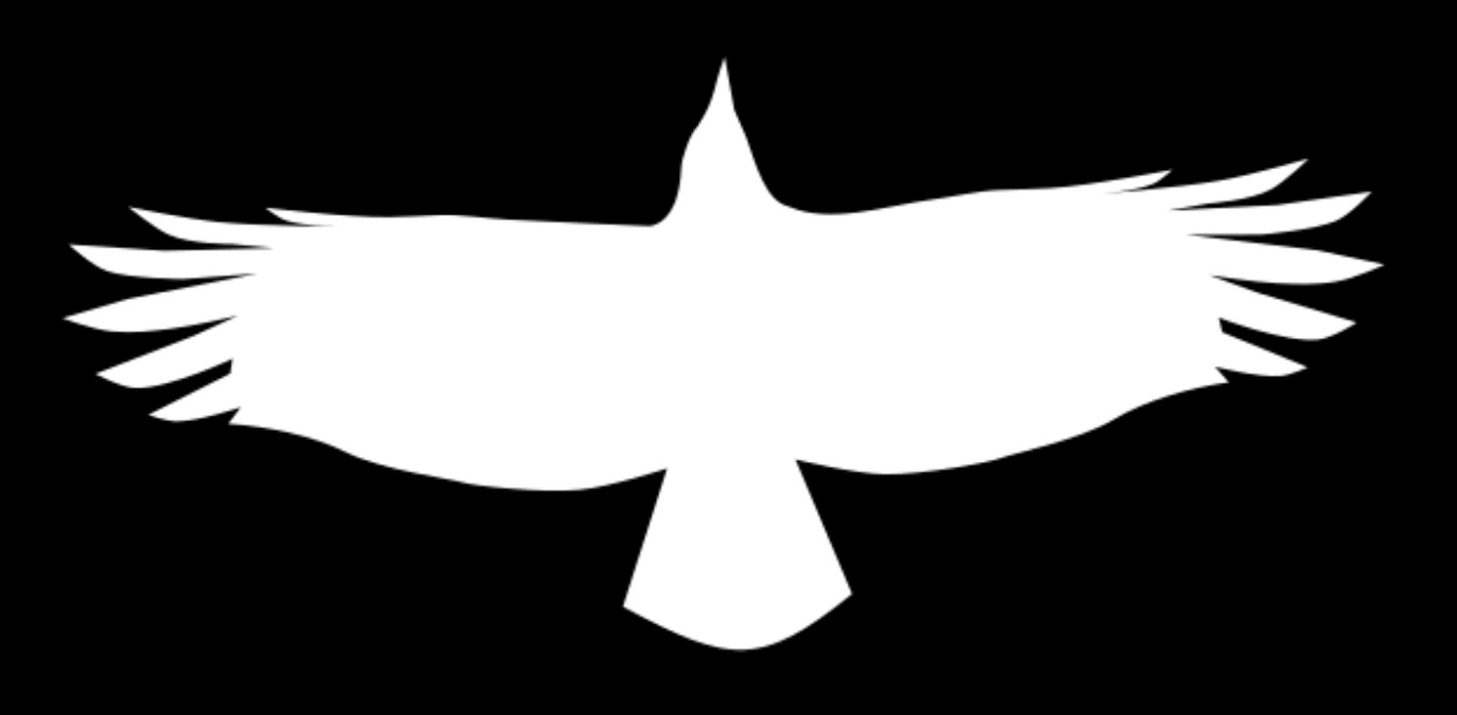
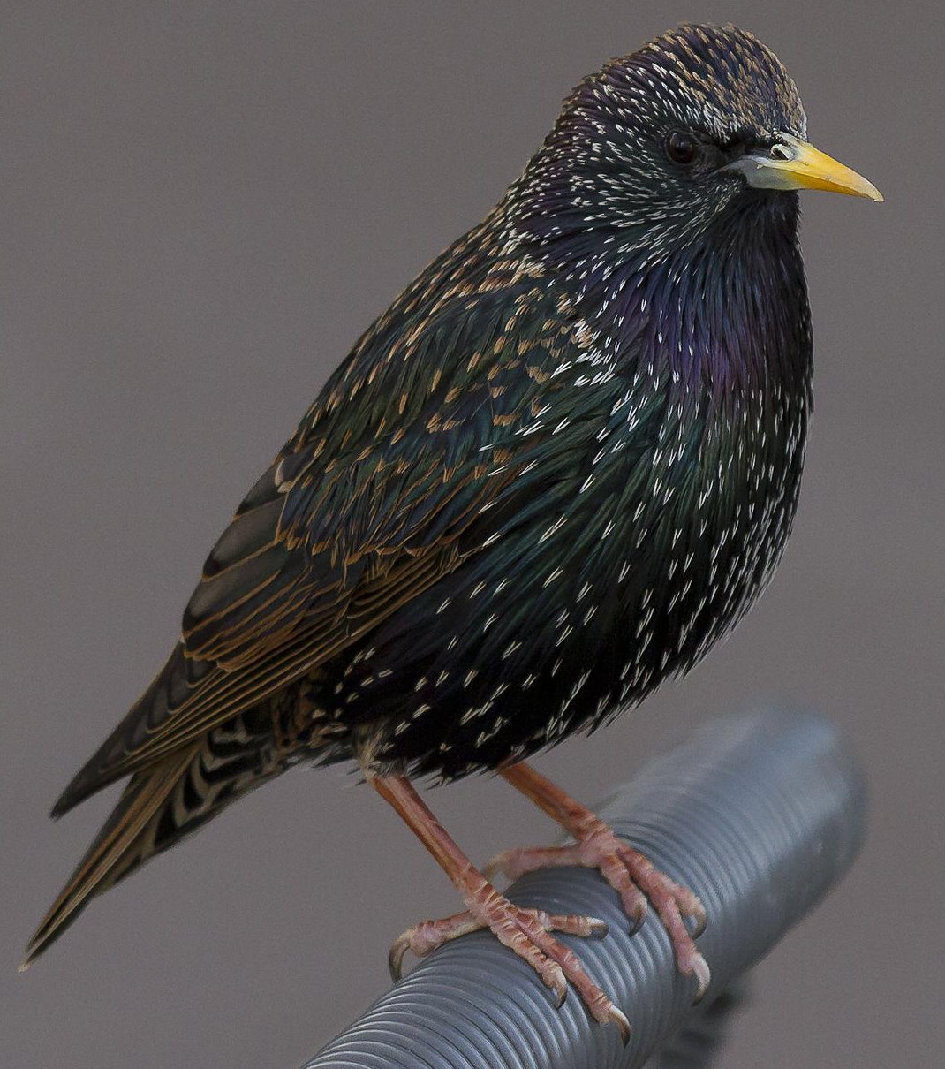
European Starling
Starlings have the same spaces in their feathers that help them to make sharp turns in the air.
Their wings are much shorter than the osprey, helping them to take off quickly.
QUICK TAKE OFF
Notes:
Birds with these kinds of wings often live in places with lots of branches, and their wings enable them to safely steer in between all the tree.
Students can test the ease of flapping with long wings and short wings using their arms, and see which way is quicker.

Slide 17
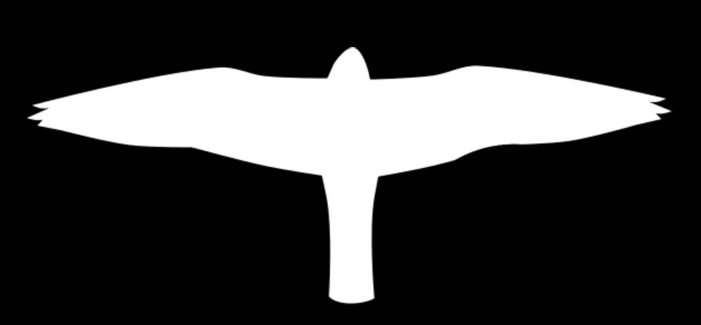
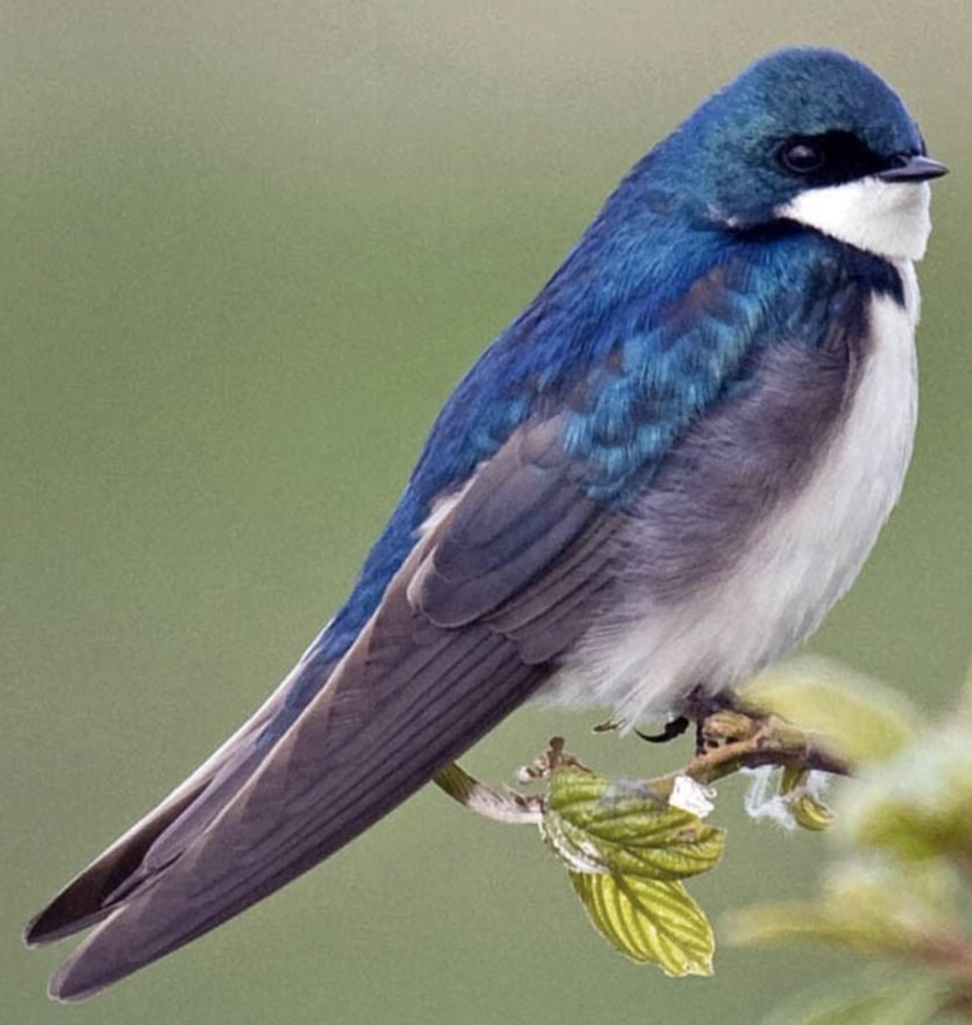
Tree Swallow
A swallow’s wings are aerodynamic just like its body, allowing it to “cut” through the air.
SPEED
Notes:
A tree swallow has a special adaptation where they can open their mouths extra wide to catch flying insects :)

Slide 18
2
3
1
4
Notes:
CHECK FOR UNDERSTANDING:
Describe an adaptation or a bird and have students hold up the # with their fingers. There is often more than one right answer.
Example questions:
Which birds are good at steering? (1 & 4)
Which birds glide long distance (2)
Which birds can stay in the air a long time without flapping (2 & 4)

Slide 19
Long wingspan for gliding
Short wings for
quick takeoff
Pointed ends for speed
Slotted ends for steering
(soaring)
Notes:
Refresher.

Slide 20
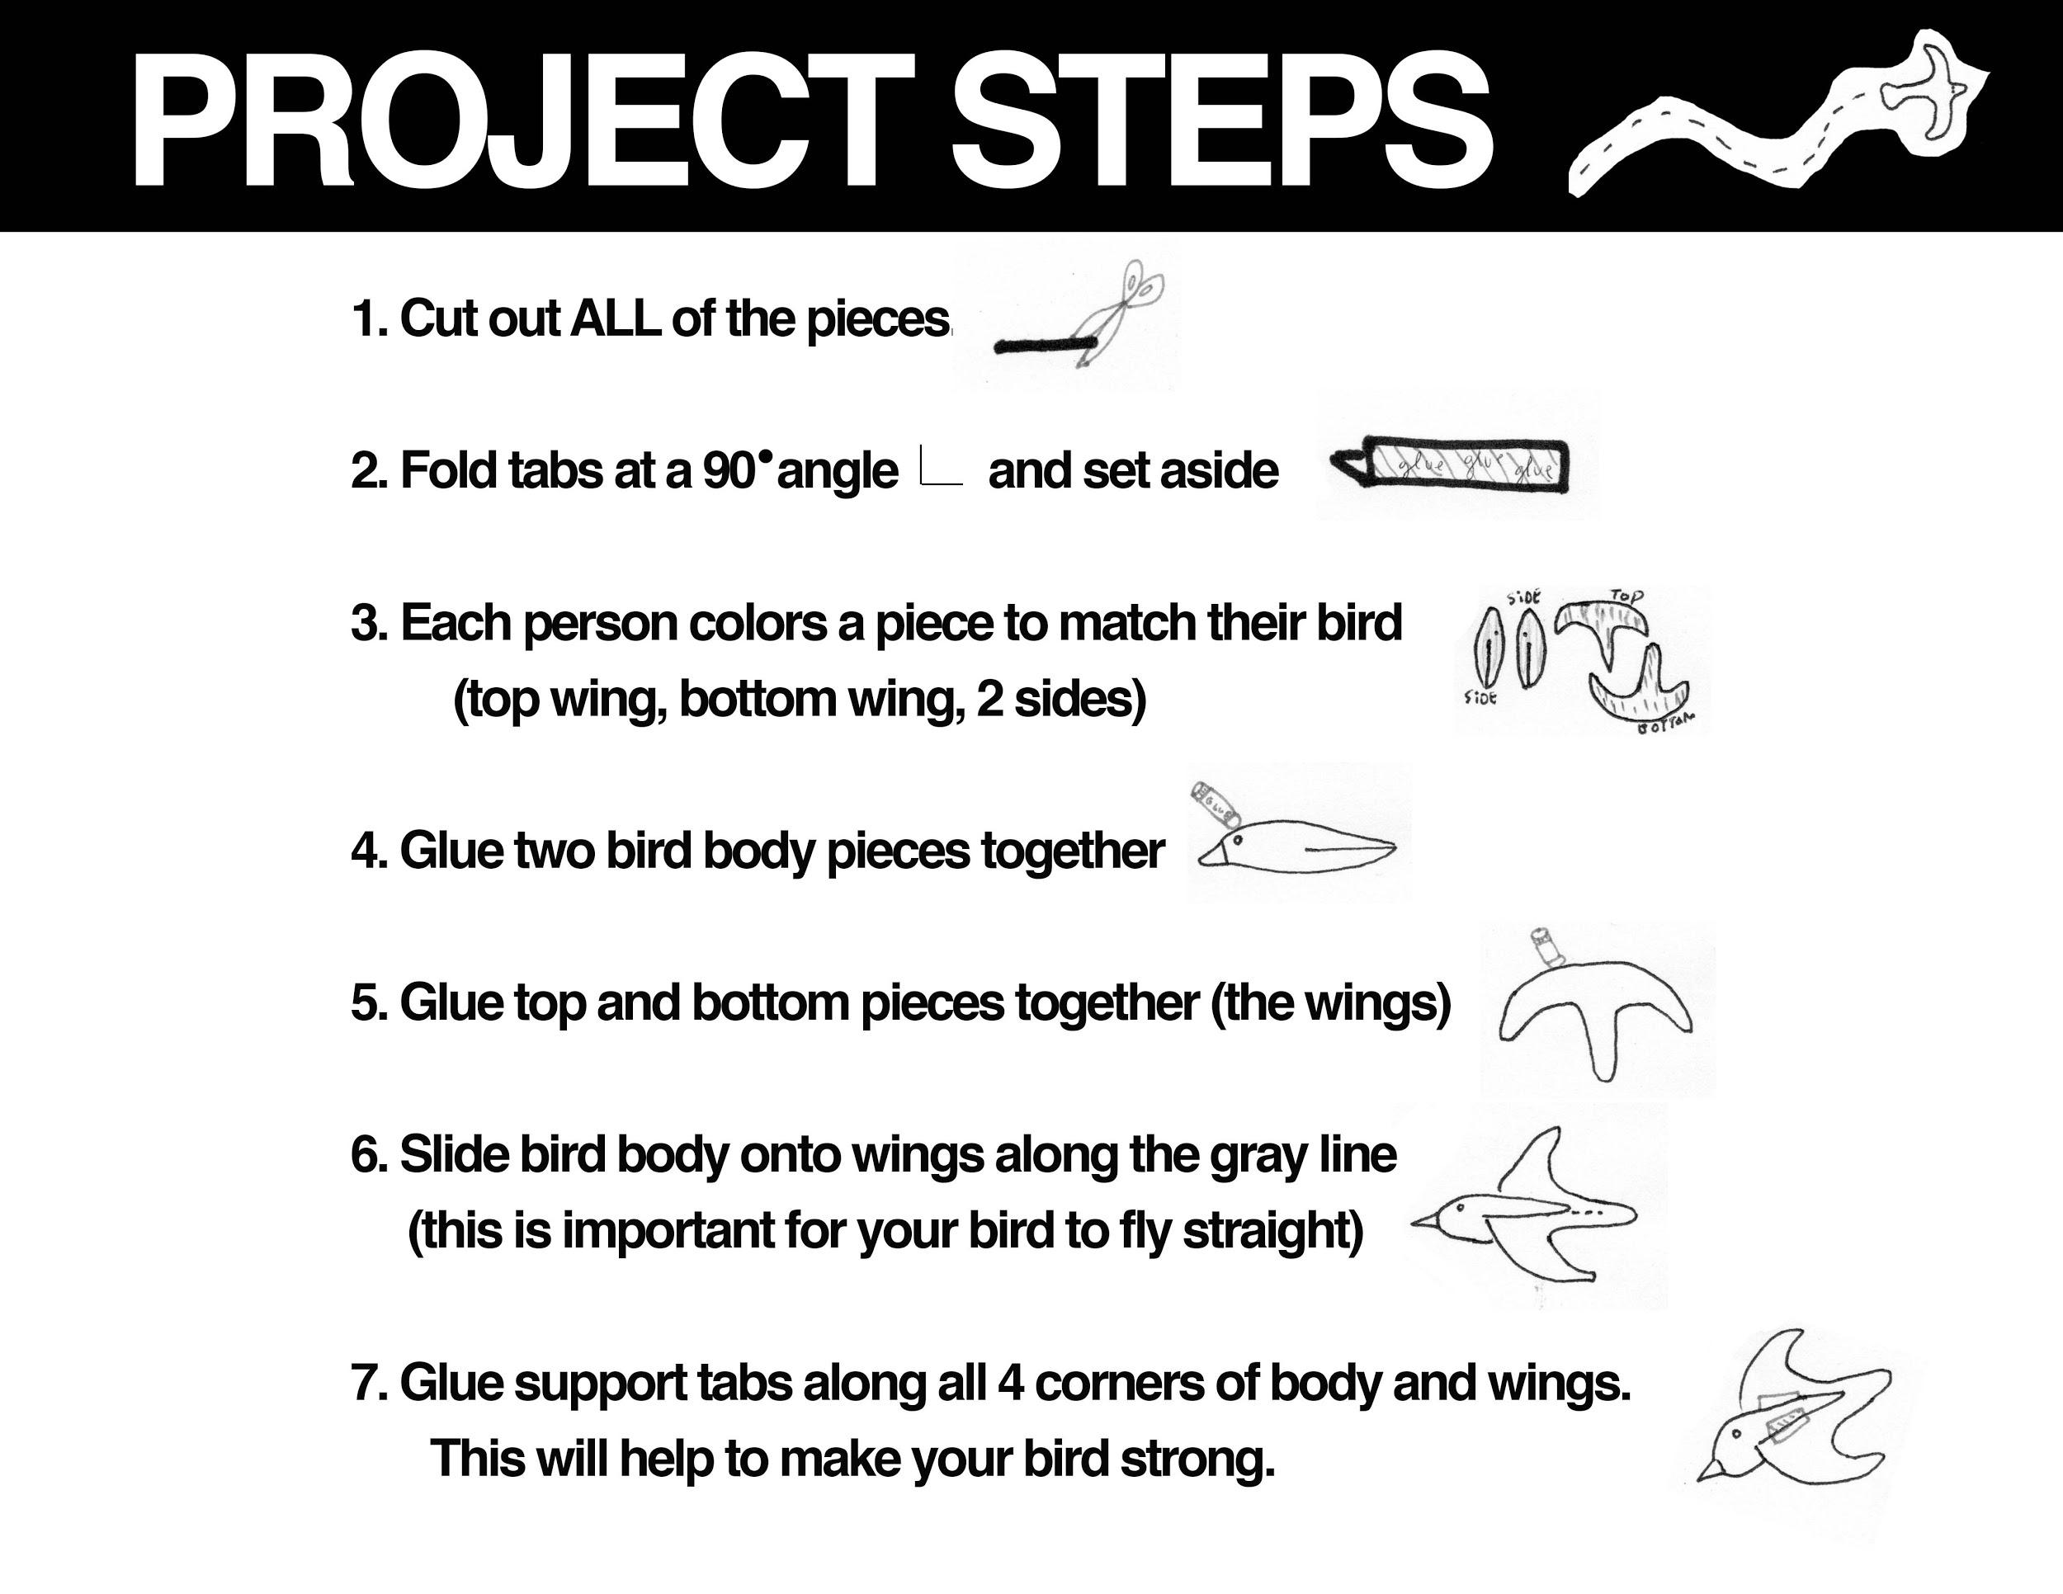
Notes:
Groups of 4 (Six to eight groups total).
Emphasize to students that they should make accurate cuts around the black lines to make their birds AERODYNAMIC
Remind them to NOT cut the gray line.
There are enough pieces for every student in the group to cut out a piece and color a piece.
The whole team needs to work together and always be working in order to finish in time. Teamwork makes the dreamwork.
They should color their bird the same as on their info sheet to help them to better identify that bird at the refuge.
They should also make sure they know some information about their bird so they can tell the class about it on the field trip.

